Slide 1
MergeSort
2nd Ed: Pg 599 – 605
3rd Ed: Pg 601 - 609
BSc in Software Development
Computer Science 1 2004/05
Notes:
BSc in Software Development - Year 2
Computer Science 1
Mergesort

Slide 2
MergeSort:
Based again on the idea of “divide and conquer”.
This time though:
  Cut the array in half
  Sort the left half
  Sort the right half
  Merge the two sorted halves into one sorted array
BSc in Software Development
Computer Science 1 2004/05

Slide 3

Because MergeSort is itself a sorting algorithm, use it again the sort the left half and the right half.
MergeSort - Recursive
  Cut the array in half
  MergeSort the left half
  MergeSort the right half
  Merge the two sorted halves into one sorted array
BSc in Software Development
Computer Science 1 2004/05

Slide 4
This outline represents the General Recursive Case.
What is the base case, the case that does not involve any recursive calls to MergeSort?
  Similar to QuickSort, if the half to be sorted doesn’t have more than one element, it has to be in its correct place, so consider it sorted and do nothing, just return.
BSc in Software Development
Computer Science 1 2004/05

Slide 5
MergeSort:
The initial call would be:
MergeSort (values, 0, numValues – 1);
void MergeSort(ItemType values[], int first, int last)
  Definition: Sorts the array items into ascending order.
  Size: values[first] .. values[last]
  Base Case: If fewer than 2 items in values[first] .. values[last] do nothing.
  General Case:
    Cut the array in half
    Sort the left half
    Sort the right half
    Merge the two sorted halves into one sorted array
BSc in Software Development
Computer Science 1 2004/05

Slide 6
MergeSort Implementation:
void MergeSort (ItemType values[],
int first, int last)
{
if (first < last)
{
int middle = (first + last) / 2;
MergeSort (values, first, middle);
MergeSort (values, middle + 1, last);
Merge (values, first, middle, middle+1, last);
}
}
BSc in Software Development
Computer Science 1 2004/05

Slide 7
Note:
The middle index is calculated by adding first to last and dividing by 2
This time the two recursive calls come next to sort the two halves of the array, first between index first and middle, and then between index middle+1 and last.
Merge() is then called to merge the two sorted halves. This is now where all the work and movement of array elements is going to take place.
Remember, in QuickSort(), all the work and movement of elements took place in Split(), which came before the two recursive calls.
BSc in Software Development
Computer Science 1 2004/05

Slide 8
Merging the two Sorted Halves:
How do we merge two sorted lists to make one larger sorted list.
Take an example:
  How do we merge 1 3 5 and 12, a sorted list with 4 elements, with 2 4 6 and 10, another sorted list with 4 elements to give 1 2 3 4 5 6 10 and 12, a larger sorted list of 8 elements
BSc in Software Development
Computer Science 1 2004/05

Slide 9
To merge the two sorted halves:
Compare successive pairs of elements, one from each half moving the smaller of the pair into another array, used for temporary storage.
When we run out of elements in one half, just copy the rest of the other half into the temporary array.
Copy the now sorted elements back from the temporary array into the original array.
BSc in Software Development
Computer Science 1 2004/05

Slide 10


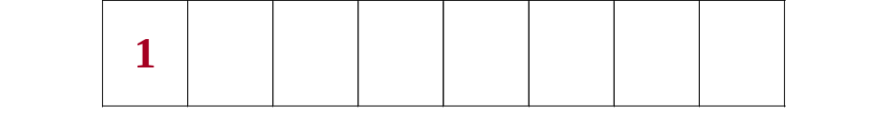
BSc in Software Development
Computer Science 1 2004/05

Slide 11

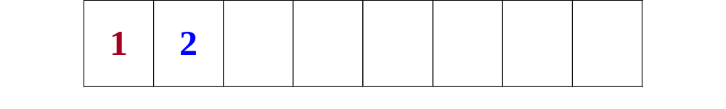
BSc in Software Development
Computer Science 1 2004/05

Slide 12

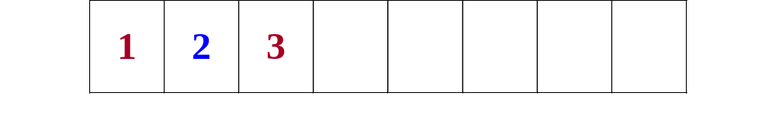
BSc in Software Development
Computer Science 1 2004/05

Slide 13

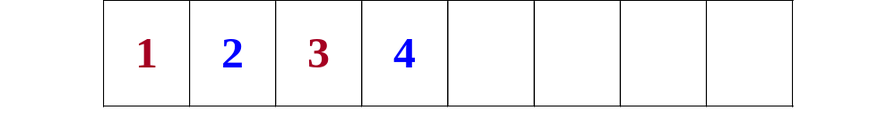
BSc in Software Development
Computer Science 1 2004/05

Slide 14

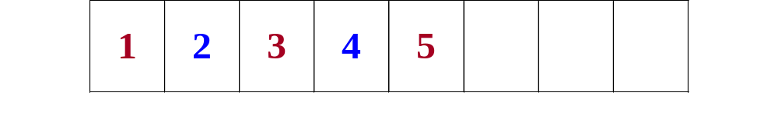
BSc in Software Development
Computer Science 1 2004/05

Slide 15

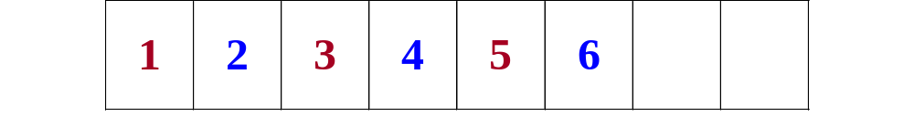
BSc in Software Development
Computer Science 1 2004/05

Slide 16

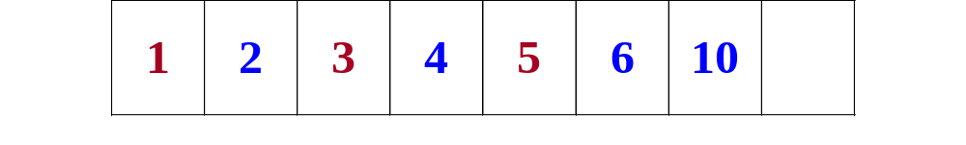
BSc in Software Development
Computer Science 1 2004/05

Slide 17
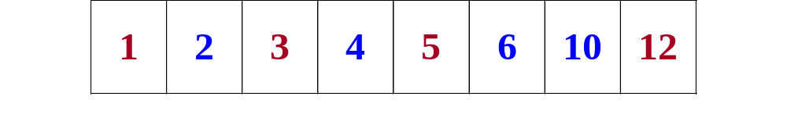
BSc in Software Development
Computer Science 1 2004/05

Slide 18
Merge:
The call is:
Merge (values, first, middle, middle+1, last);
void Merge (ItemType values[], int leftFirst, int leftLast,
int rightFirst, int rightLast)
  Function: Merges two sorted subarrays into a single sorted piece of the array.
  Preconditions:
  values[leftFirst] .. values[leftLast] are sorted;
  values[rightFirst] .. values[rightLast] are sorted.
  Postcondition:
    values[leftFirst] .. values[rightLast] are sorted.
BSc in Software Development
Computer Science 1 2004/05

Slide 19
Merge Algorithm:
Set saveFirst to LeftFirst // to know where to copy back
Set index to leftFirst
While more items in left half AND more items in right half
If values[leftFirst] < values [rightFirst]
Set tempArray[index] to values[leftFirst]
Increment leftFirst
else
Set tempArray[index] to values[rightFirst]
Increment rightFirst
Increment index
Copy any remaining items from the left half to tempArray.
Copy any remaining items from the right half to tempArray.
Copy the sorted elements from tempArray back into values.
BSc in Software Development
Computer Science 1 2004/05

Slide 20
Notes:
leftFirst and rightFirst indicate the "current" position in the left and right halves, respectively.
Because these are value parameters, the changed values are not passed back out of Merge() (value parameters => a copy and it is the copy that is changed in Merge(), leaving the original locations unaltered.)
Both of the "copy any remaining elements" loops are included.
During an execution of the Merge() function only one of these loops will execute (the other one won’t). Why??
BSc in Software Development
Computer Science 1 2004/05

Slide 21
Merge Implementation:
void Merge ( ItemType values[], int leftFirst, int leftLast,int rightFirst, int rightLast)
{
ItemType tempArray[MAX];
int index = leftFirst;
int saveFirst = leftFirst;
BSc in Software Development
Computer Science 1 2004/05

Slide 22
while ((leftFirst <= leftLast ) &&
(rightFirst <= rightLast))
{
if (values[leftFirst] < values[rightFirst])
{
tempArray[index] = values[leftFirst];
leftFirst++;
}
else
{
tempArray[index] = values[rightFirst];
rightFirst++;
}
index++;
}
BSc in Software Development
Computer Science 1 2004/05

Slide 23
while (leftFirst <= leftLast)
{
tempArray[index] = values[leftFirst];
leftFirst++;
index++;
}
while (rightFirst <= rightLast)
{
tempArray[index] = values[rightFirst];
rightFirst++;
index++;
}
for (index = saveFirst; index <= rightLast; index++)
values[index] = tempArray[index];
}
BSc in Software Development
Computer Science 1 2004/05

Slide 24
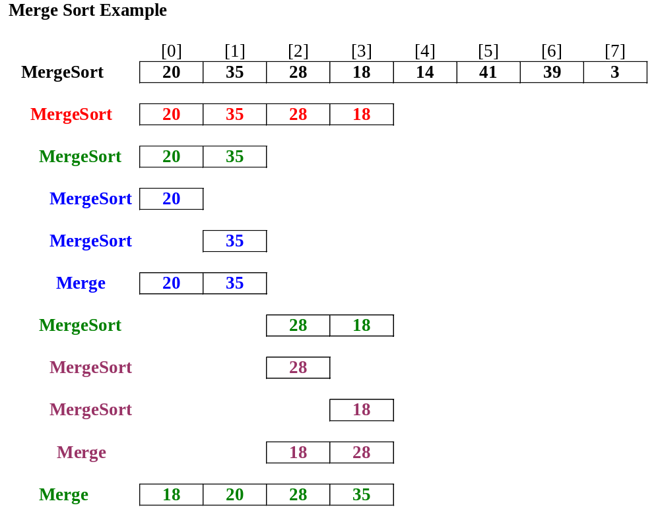
BSc in Software Development
Computer Science 1 2004/05

Slide 25
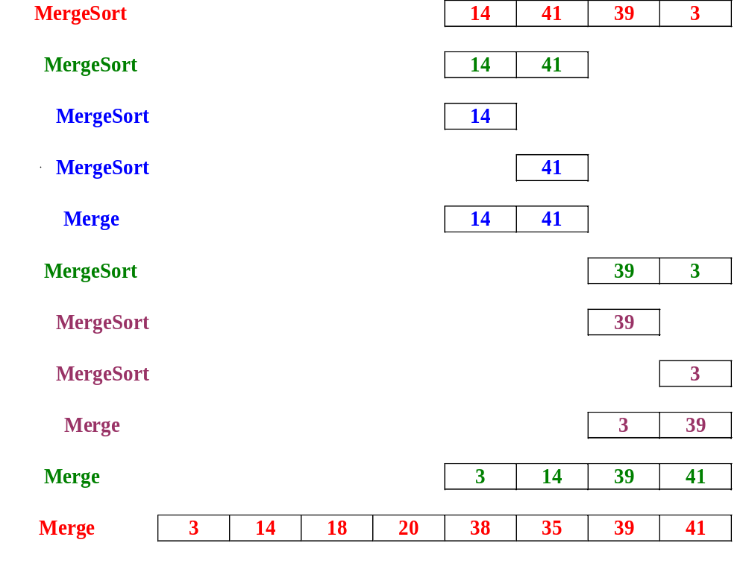
BSc in Software Development
Computer Science 1 2004/05

